Slide 1
Diversity in Higher Education
Understanding university diversity - Part 2
Recognizing students' academic background
Socio-cultural differences and learning environments for diverse students
International students and special needs

Slide 2
The choices we make regarding diversity
We can choose to see student variation and diversity as a problem or an obstacle between us and our teaching.
We can choose to celebrate diversity and enrich the content and method we use.
This Photo by Unknown Author is licensed under CC BY-SA

Slide 3
The Dynamics of Diversity in the Teaching-Learning Process: Responsive-Inclusive Pedagogy
Student: Know who they are
Course Content: What we teach?
(Curriculum)
Teaching Method: How we teach?
(Pedagogy)
Responsive-
Inclusive
Pedagogy
Lecturer: Know oneself

Slide 4
Towards a responsive and inclusive pedagogy
Respect all individuals in your course.
Embrace cultural differences.
Practice welcoming environment.
Support all learners.
Realize that all can learn from each other.
As the instructor, you are also learning from your students.
Activity
Read https://cirtlincludes.net/wp-content/uploads/2018/03/Inclusive-Pedagogy-Framework.pdf

Slide 5
The Dynamics of Diversity in the Teaching-Learning Process: The Students
Student: Know who they are
Course Content: What we teach?
(Curriculum)
Teaching Method: How we teach?
(Pedagogy)
Responsive-
Inclusive
Pedagogy
Lecturer: Know oneself

Slide 6
LEARNER DIVERSITY
Refers to the identity encompassing a wide range of characteristics, including (among others)
race and ethnicity
culture
gender
linguistic background
socio-economic status
family life
religion

Slide 7
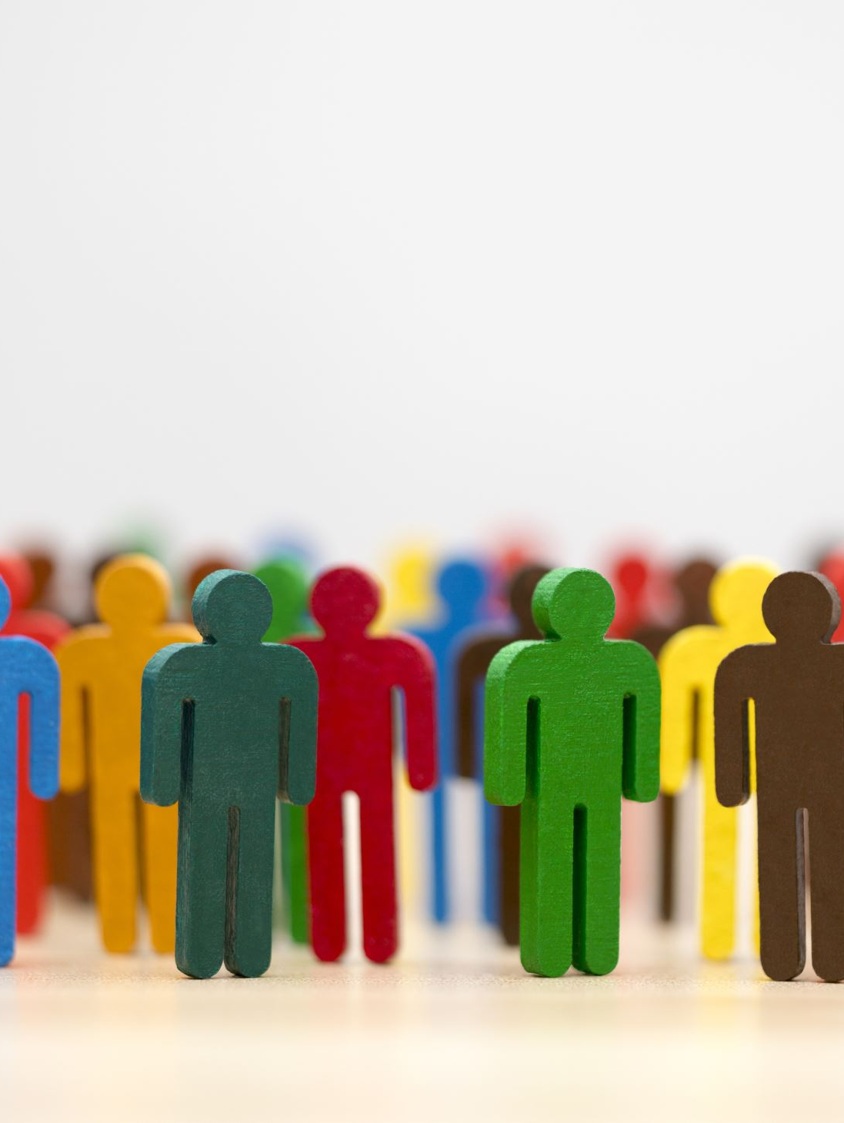
LEARNER DIVERSITY (continue)
Refers to the identity encompassing a wide range of characteristics, including (among others)
interests
physical
emotional challenges
skills and abilities
motivation and life experiences

Slide 8
Dimensions of differences
Paine (1990) proposes 4 layers of differences:
Individual difference
Dispositions, interests
Sex, age
Categorical difference
Gender (social classification)
Social class
Race
Contextual difference
Relational difference (e.g., being a man or a woman)
Difference is created, maintained, and changed due to the social context
Pedagogical difference
Giver of knowledge
Receiver of knowledge
Have pedagogical implications
Consequences for both teaching and learning

Slide 9
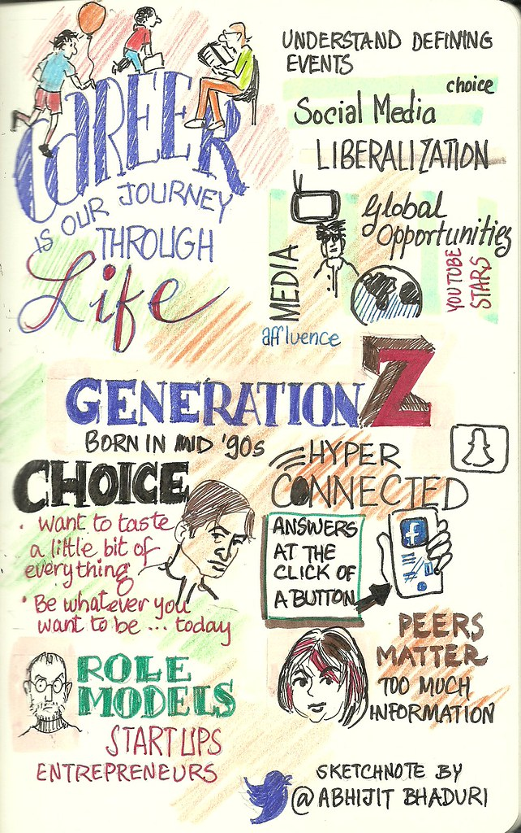
Generation gap
Generation Z
Characteristics:
Born after 1995
Digital natives
Native use of technology
They have access to abundant information
Too much screen time may affect social skills
Build personal brand using social media
“Gen Z" by Abhijit Bhaduri is licensed under CC BY 2.0.
Source: Casey Foundation (2021); Dimock(2019)

Slide 10
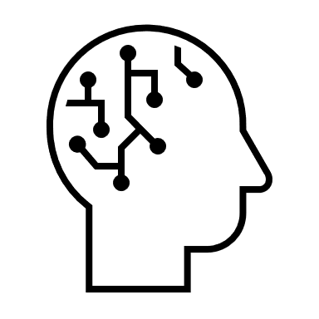
Multiple Intelligences:
How are you SMART?
Activity: http://literacynet.org/mi/assessment/findyourstrengths.html

Slide 11
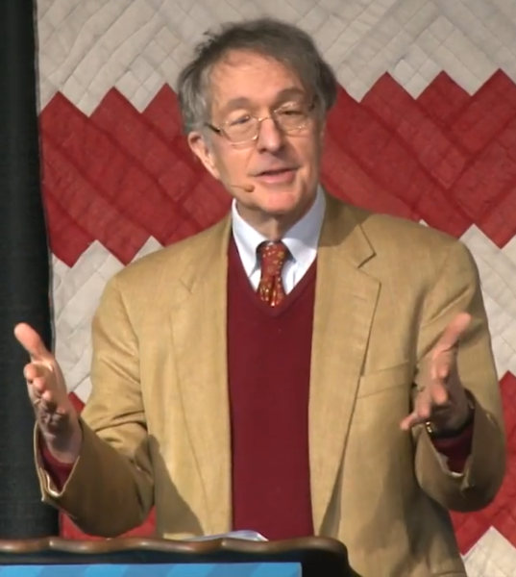
Howard Gardner’s Approach (Neurological Evidence)
Intelligence has various aspects (frames of mind)
All the intelligences are interdependent & function in harmony
Multiple Intelligences
Linguistics
Musical
Logical-Mathematical
Spatial
Bodily-Kinesthetic
Intrapersonal
Interpersonal
Naturalist
Existential
Citizen University: Howard Gardner- "Can We Raise Good Citizens?“ by Wikimedia Commons is licensed under CC BY 3.0

Slide 12
12
People smart
Picture smart
Nature smart
Multiple Intelligence
Music smart
Body smart
Logic smart
Word smart
Self smart
“Multiple Intelligence" by Julia Lee / Universiti Malaysia Sarawak is licensed under CC BY-NC-4.0.

Slide 13
Multiple Intelligences
What kind of SMART does your student possess?

Slide 14
Parting words
Be responsive
Be inclusive
Embrace diversity
Embrace differences
Empathize
Change begins with me
 | THINK | REFLECT | CHANGE

Slide 15
THANK YOU

Slide 16
References
CIRTL INCLUDES (n.d.). Inclusive Pedagogy Framework. Retrieved July 14, 2022, from https://cirtlincludes.net/wp-content/uploads/2018/03/Inclusive-Pedagogy-Framework.pdf
Dimock, M. (2019, January 17). Defining generations: Where Millennials end and Generation Z begins. https://www.pewresearch.org/fact-tank/2019/01/17/where-millennials-end-and-generation-z-begins/
Messiou, K., Ainscow, M., Echeita, G., Goldrick, S., Hope, M., Paes, I., Sandoval, M., Simon, C., & Vitorino, T. (2016). Learning from differences: a strategy for teacher development in respect to student diversity, School Effectiveness and School Improvement, 27:1, 45-61, DOI: 10.1080/09243453.2014.966726
Paine, L. (1990). Orientations toward diversity: What do prospective teachers bring? East Lansing, MI: National Center for Research on Teacher Education.
Seng, T. O., Parsons, R. D., Hinson, S. L., & Sardo-Brown, D. (2003). Educational Psychology: A Practitioner-Researcher Approach. Singapore: Thomson- Learning.
The Annie Casey Foundation (2021, April 14). What are the core characteristics of Generation Z? https://www.aecf.org/blog/what-are-the-core-characteristics-of-generation-z

Slide 17
Useful websites on Inclusive Teaching
http://www.crlt.umich.edu/research-basis-inclusive-teaching
https://commons.georgetown.edu/teaching/design/inclusive-pedagogy/
https://cft.vanderbilt.edu/guides-sub-pages/increasing-inclusivity-in-the-classroom/
Lawrie, G., Marquis, E., Fuller, E., Newman, T., Qiu, M., Nomikoudis, M., Roelofs, F. & van Dam, L. (2017). Moving towards inclusive learning and teaching: A synthesis of recent literature. Teaching & Learning Inquiry: The ISSOTL Journal, 5(1), 10.

Slide 18
Useful Websites on Universal Design Learning
https://blog.yorksj.ac.uk/moodle/2015/11/30/universal-design-for-learning-udl/
www.cast.org/our-work/about-udl.html#.Xc6Sw25uLJo

