Slide 1
Neuro-Cognitive science for STEM
Norsiah Fauzan

Slide 2
What is Neuro-Cognitive Science
Cognitive neuroscience is an interdisciplinary area focusing on the application of neuroscience knowledge in the diverse areas such as neuroimaging studies, computer science, psychology, marketing, business, general and special education, speech and language sciences, social sciences, engineering, biology, learning science, health, etcetra

Slide 3
Sustainable Development Goals
Cognitive neuroscience, emerges as one of the sustainable development goals (SDGs) towards 2030 [1-30] and a critical component in the science, technology and innovation (STI) agenda towards 2050 (see Figure 1)

Slide 4
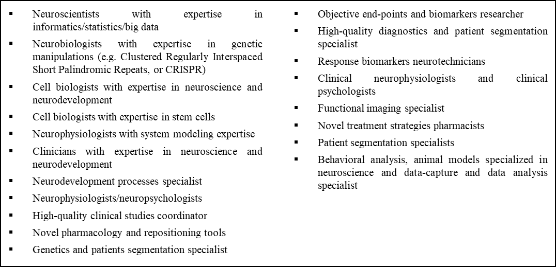
The Needs for Neuro-Cognitive Scientist

Slide 5
The Emergence of Neuro-Technology
1.Neurological Healthcare
The rise in neurological diseases and mental health resulted in the increasing need for neurological healthcare in Malaysia.
Corresponding improvement and innovation with emphasis on management, diagnosis and treatment are essential.
The multidisciplinary expert collaboration from clinical neuroscience, cognitive neuroscience, neuroimaging, pharmaceutical science and other fields would be beneficial improve understanding of human brain function, diagnosis and treatment of brain-related diseases, monitoring of the progression of brain-related disease and development of novel diagnostic and treatment methods.
Inevitably, the development of algorithm for the analysis of big data from healthcare database is critical.

Slide 6
Advance in Neuroimaging Modalities
2.0 Brain Fingerprinting: -a powerful tool for measuring human cognitive brainwaves and brain response. Growing interest in brain fingerprinting is also promoting a new level of security identification and verification systems.

Slide 7
Brain based Education
Although cognitive neuroscience is a new discipline, recent findings promote its development and show its potential to transform educational practices in Malaysia by 2050.
The application of knowledge in neuroscience and technology related to the educational theories and practices will advance the understanding of the cognitive processes, mind and academic performances of normal students and special needs children.
Educators have to be creative and flexible in their effort to apply instructional strategies relevant to the students’ needs in learning.

Slide 8
New Wave Marketing
Neuromarketing is a new branch of marketing that explores the mysteries of consumer purchase behaviours, preferences, emotional influences and decision-making processes [4-17].
Neuromarketing helps the marketing analyst understand the process taking place in the consumers’ brain during the buying process, that is, the consumer reaction to packaging forms, colours, sizes, designs, product information and advertisements [17].
Globally, there are dozens of companies (e.g. Brain Intelligence, Buyology, FKF Applied Research, Forebrain, Innerscope Research, Institute of Sensory Analysis, Keystone Network, Merchant Mechanics, Mindlab International, MSW Research (MSW/Lab), Neurensics, Neuro-Insight, NeuroFocus, Neurosence, NeuroSpire and One-to-One Insight) using brain technology to explore consumers’ behaviours, emotions, memory and decision-making processes [17].

Slide 9
The growth of the neuromarketing field in Europe and the United States is opening a new wave in marketing analysis and strategies in Malaysia.

Slide 10
Big Data from Mind, Behaviour, Brain and Neurosciences
It is estimated that data from animal, human and many other sources will be open access and standardised to allow researchers worldwide to find ways to prevent, control or cure diseases of the mind, behaviour, brain and neuroscience. Table 2 shows the current and future needs of big data.

Slide 11
Figure 2

Slide 12
Conclusio
The emergence of neurotechnology is bringing cognitive neuroscience to a new level towards 2050. More experts in the field are required to face the challenges of the 21st century and to implement the STI agenda by 2050. Cognitive neuroscience subfields such as computational neuroscience, neuroinformatics, brain imaging, brain fingerprinting, neuroeducation and neuromarketing can help address various issues associated with the brain, improving social well-being and lifestyle and transforming the socio-economic face of Malaysia.
Brain awareness program derived from knowledge transfer program were carried out in different states in Malaysia with the goal to encourage high school students into brain science and gradually into scientific research careers, including neuroscienceresearch. These are the activities selected based on their ease of implementation

