Slide 1
Nuclear Medicine Information System for Sarawak General Hospital
¹Yeoh Seow CHEN, ²Nung Kion LEE, ¹Chih How BONG, ³Mohd HAMDI Mahmood
²Faculty of Cognitive Sciences and Human Development
¹Faculty of Computer Sciences and Information Technology
³Faculty of Medicine and Health Sciences

Slide 2
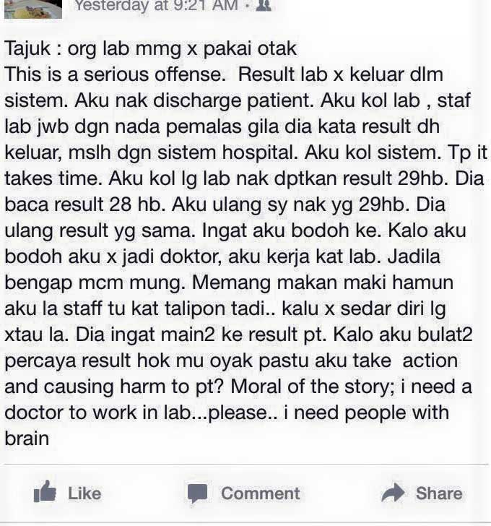
A little story …
There are 3,616 government health facilities including 135 public hospitals, 2,813 rural clinics and 668 government dental clinics.
However, those facilities are equipped with partially integrated hospital information system.
Challenges might arise for example data in nuclear clinic appointment may be in the system; however the actual data is only available in physical format.
Also it becomes challenging as to integrate with other sections even within own department; refer to other department and retrieve data for research.

Slide 3
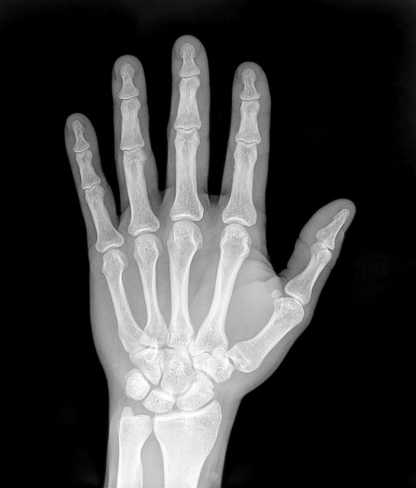
A brief background of this project
Manual Storage and Retrieval at Nuclear Medicine Department
Doctors
Paper-based file
Patients
DICOM format
Officer
Other users

Slide 4
Weaknesses of the manual system
Inefficient
Waste of resources
Accuracy, Integrity, and Confidentiality issues

Slide 5
Objectives of this project
To develop a computerized online information system that integrates patients’ spatial information (diagnostic images) and their personal records.
Specifically
To develop a user friendly web-based system that minimizes user errors.
To develop a retrieval system for effective and efficient retrieval of nuclear images records and patient information.
To develop a system for manage different assess types.

Slide 6
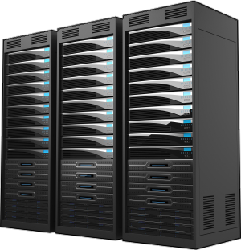
Ideal System Framework
Reception system
Billing system
Ordering system
Electronic medical records
Hospital room management
Hospital Information System (HIS)
Request nuclear medicine test
Send patient’s radiology result
HL 7 standard
NMIS
Report
Send Patient information
Receive the inspection execution information
DICOM
PET scan
Receive and saves the inspection images
Picture Archive Communication System (PACS)
Modality

Slide 7
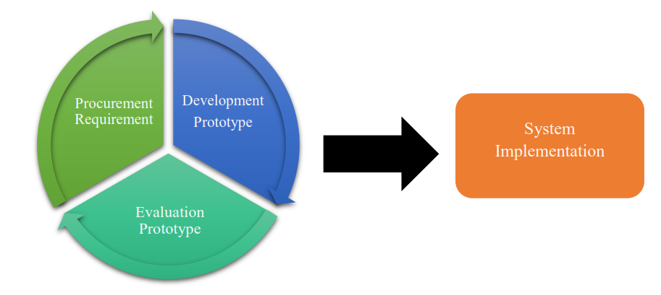
Method
Rapid Prototyping

Slide 8
Core functions of NMIS
patient registration, appointment arrangement, workflow management, image collection and reporting capabilities;
item inventory to keep track the drugs, radioactive tracers, radioactive and non-radioactive substances;
calculation program to calculate both the radiopharmaceutical dose for particular patient based on the body weight and maximum acceptable action and the radioactivity remains per unit volume for each radioisotopes based on its half-life

Slide 9
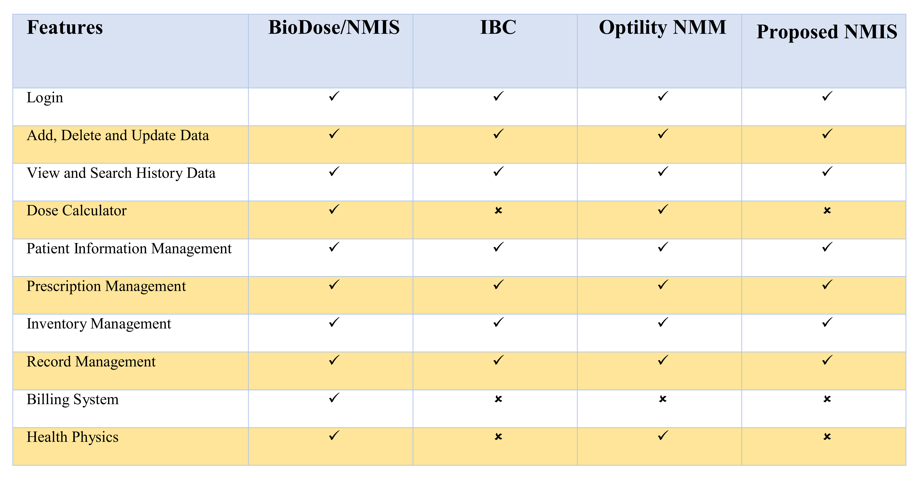
Comparisons of features with existing commercial products

Slide 10
Proposed NMIS at SGH
Doctors
Manage
appointment
Send patient’s radiology result
Registration
Send Patient information
NMIS
Request nuclear medicine test
Retrieve information
Officer at NMD
DICOM
PET scan
Receive and saves the inspection images
Picture Archive Communication System (PACS)
Modality

Slide 11
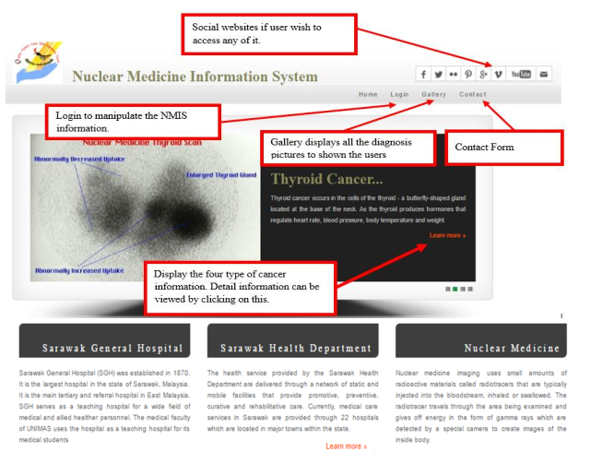
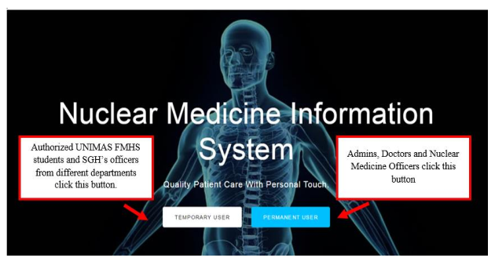
Screenshots Demonstration
LOGIN PAGE
MAIN PAGE

Slide 12
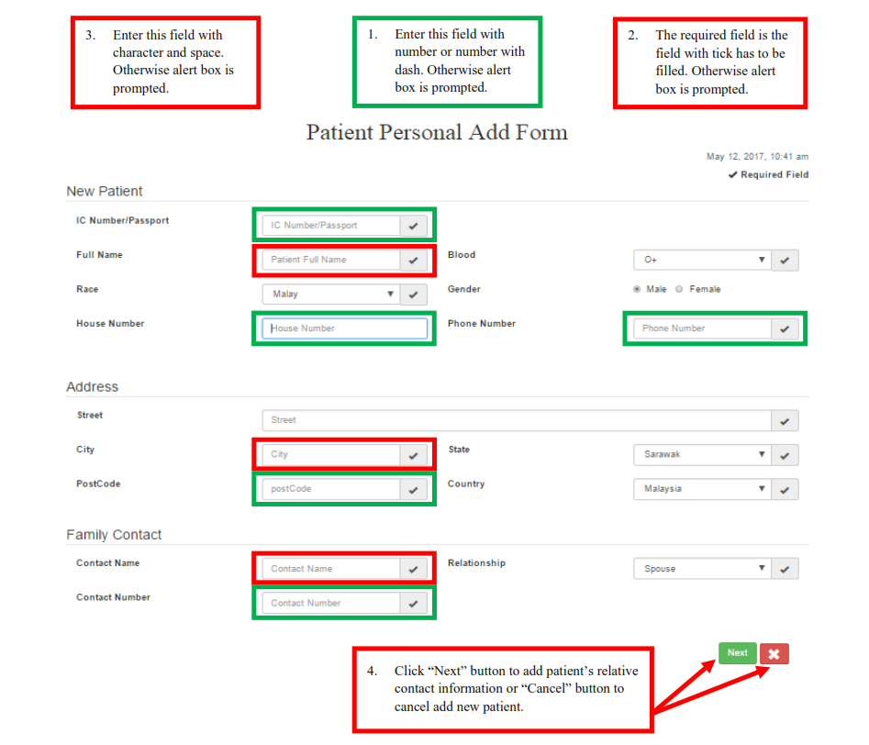
Patient Registration

Slide 13
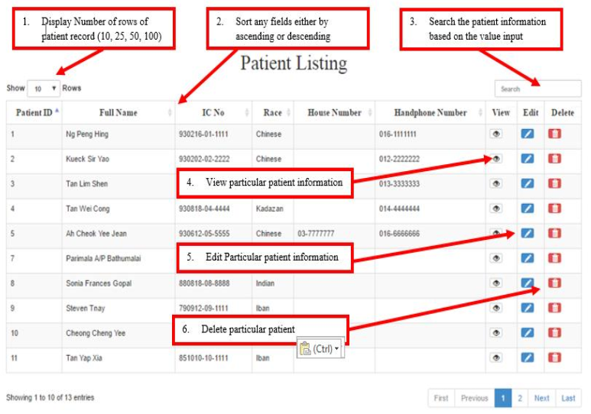
Patient listing

Slide 14
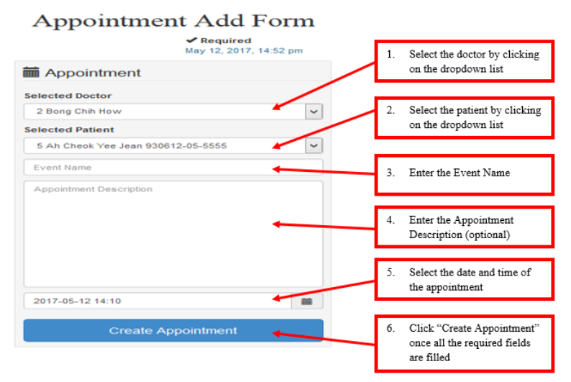
Making an Appointment

Slide 15
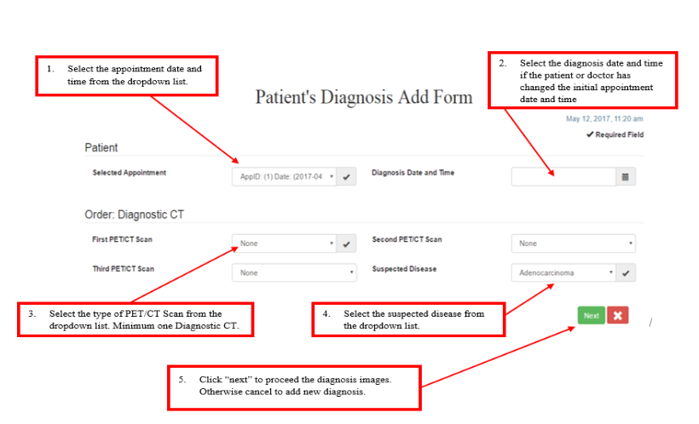
Adding Patient Diagnostic

Slide 16
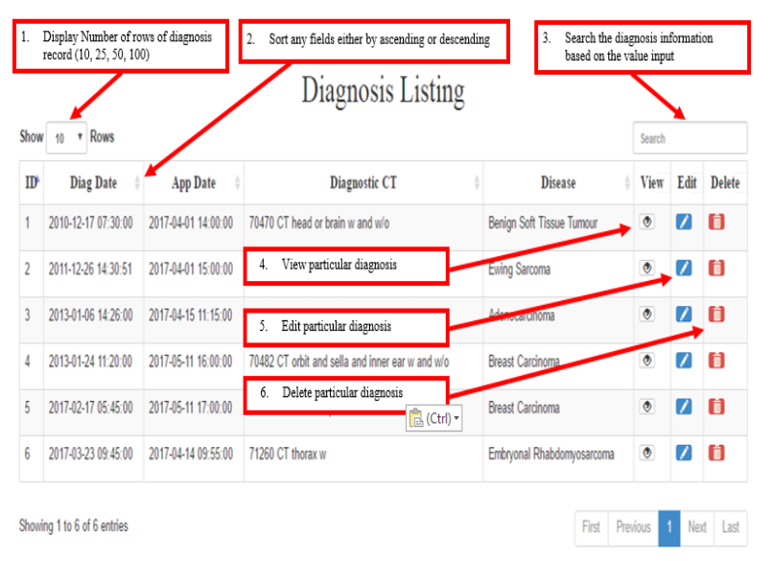
Retrieval of Information

Slide 17
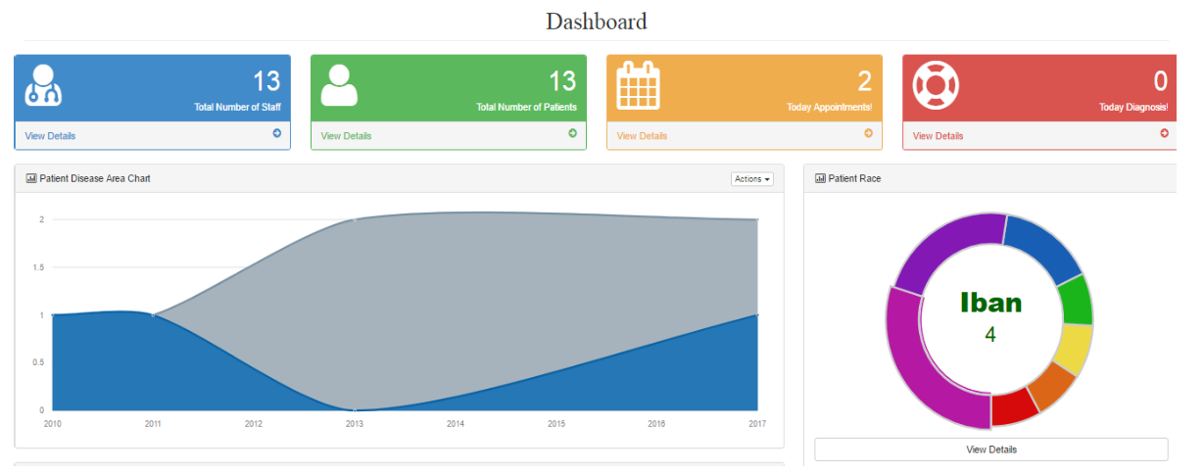
Dashboard

Slide 18
Benefits of NMIS
Generation of general statistics of patients and diseases rapidly.
Generation of specific statistics using the data capture.
Accuracy and integrity of data captured.
Improved workflow–reduced communication overhead, systematic workflow
Data for strategic planning and better decision making.
Future development of Artificial Intelligence application
A step forward for systems integration of various systems in hospitals

Slide 19
Thank you!
Medical Information System Group
University Malaysia Sarawak
*Dr Mohammad Hamdi bin Mahmood
Dr Bong Chih How
Dr Lee Nung Kion
*contact person-mmhamdi@unimas.my

