Slide 1
A roadmap towards the potential usage of ICT in Buayan: Preliminary study
Cheah Wai Shiang, Mohamad Nazri Khairuddin and Kartinah Zen

Slide 2
Introduction
Kg. Buayan is in the district of Penampang, Sabah.
Although the telecenter has raised the awareness and usage of ICT in the community, several research questions occur, such as how far the ICT is able to improve the socio economic of the community? What are the ICT applications that beneficial to the community?
This requires a careful study of the needs among the community by ethnographer.
We present various models in identifying the potential usage of ICT4D. The models are able to reflect various aspects of ICT4D in Buayan.
We present how to make decision based on those model.

Slide 3
Research methodology
Interview the site leader of Buayan.
Examine 50 documentations in studying the impact of ICT4D.
Generalized the attributes and use for models representation.
Feasibility study of the models in term of decision making.

Slide 4
Proposed model: Who are the target ICT users in the community?
Figure 1: Role model hierarchy that modelled the target user for ICT4D in Buayan

Slide 5
Proposed model: How does the ICT serve the community?
In general, the ICT can improve the socio economic of the community by fulfilling various goals as modelled in Figure 2. However, does the community really need all the ICT products in fulfilling their goals? What will be the favorable applications in Buayan community?
Figure 2: Goal model for ICT4D in Buayan
Notes:
Go back to the site leader.

Slide 6
Niche area to go…
How to go from here!!!
Figure 3: Goal model to present the niche ICT usage in Buayan

Slide 7
The information to gain from the system…
Figure 4: Domain model for handling education in ICT4D in Buayan

Slide 8
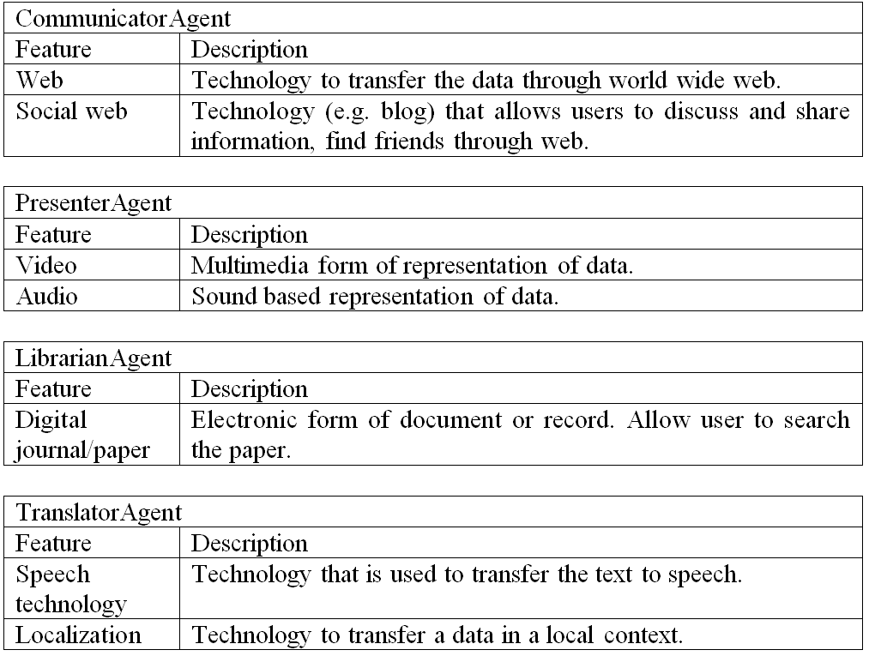
Technological probe for ‘handle education’
Figure 5: Agent role mapping model for ICT4D in Buayan
Table 2: Technology probe models

Slide 9
Conclusion
We present various aspects of the potential usage of ICT for Buayan community and use those models for ICT decision making process.
The contribution of this research is two-folds.
We introduce new artifacts for the ethnography study. It is able to explicit prescribe the potential usage of ICT4D. On the other hand, the models that presented in the paper able to provide a cross cut on introducing any ICT applications to the community.
In future,
Model representations for other ISITI sites.
Use those models for software development.

